Slide 1
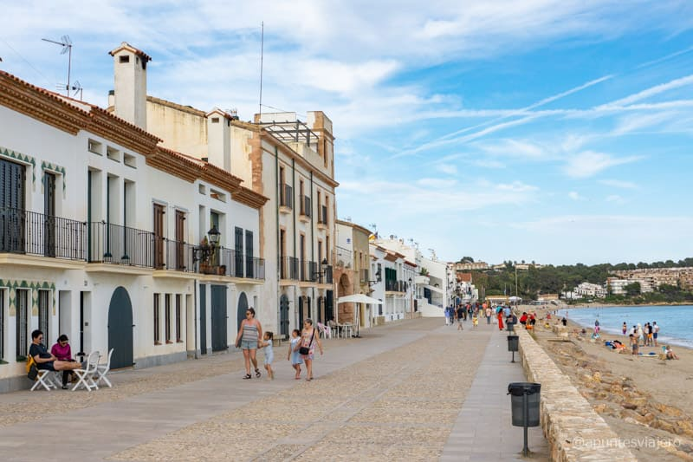
Altafulla Count Challenge

Slide 2

How many times was ”cloud migration” mentioned today?

Slide 3

Code challenge

Slide 4
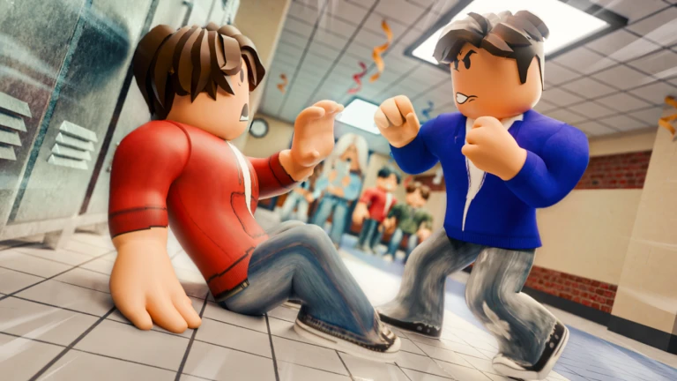
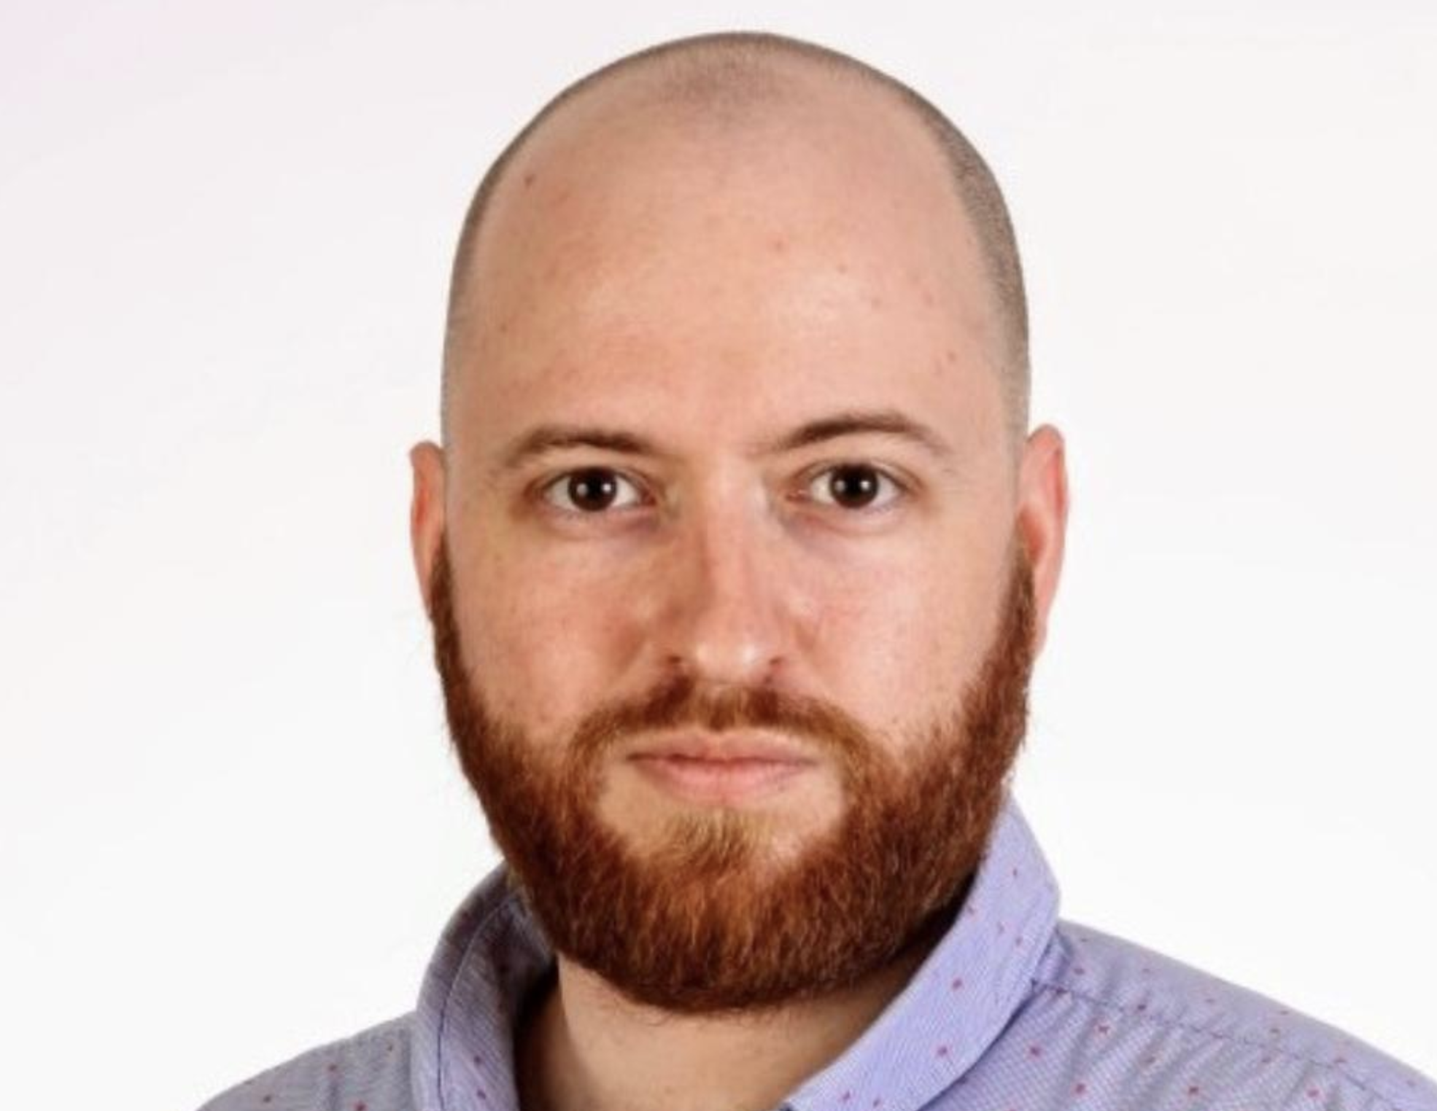
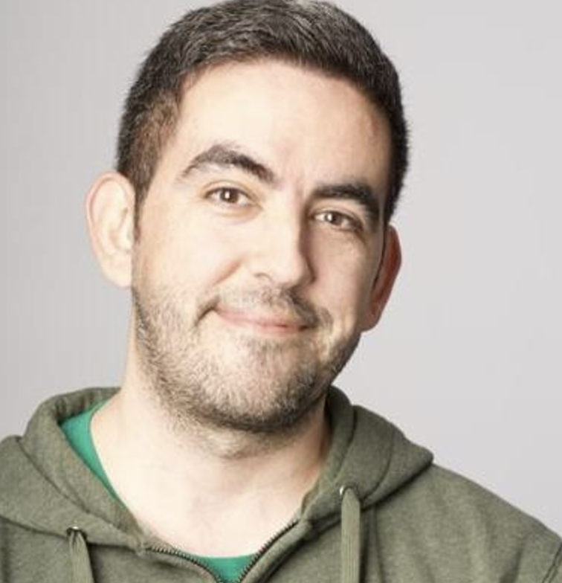

Slide 5

Altafulla Code Challenge

Slide 6
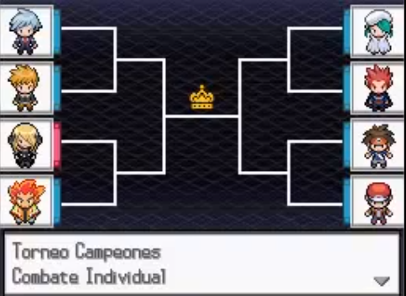
Welcome to the Altafulla Pokemon Tournament
Choose your Pokemons!
Teach them the best movements and train them how to fight

Slide 7
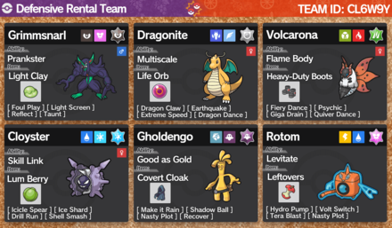
How to participate
Create a team with the available Pokemons (1st gen)
Select 4 movements for each pokemon
Create a PR to register your team

Slide 8
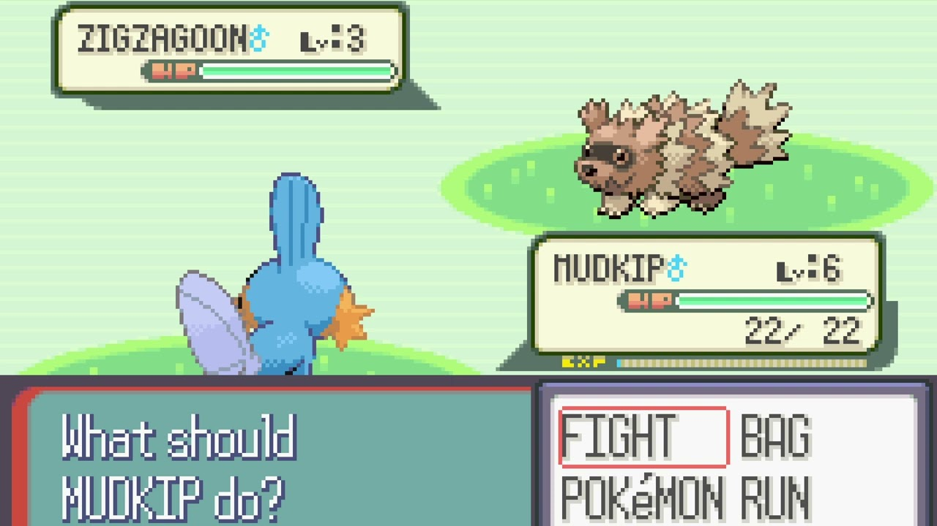
Tournament
All teams fights against all others to the best of 5 fights
If you win one fight, you get one point
The team that gets more points wins.
Contributions will be open until 9.00 – 20 Nov

Slide 9

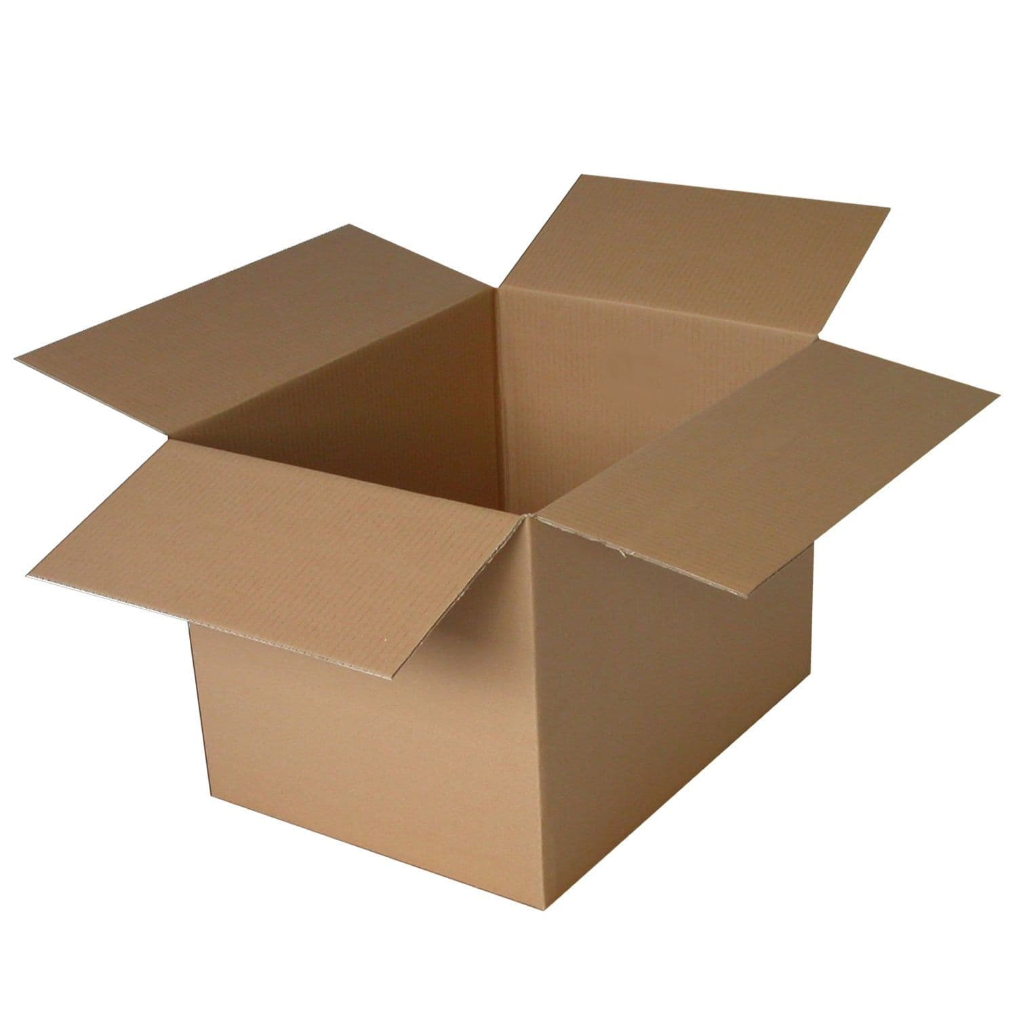
Prize

Slide 10

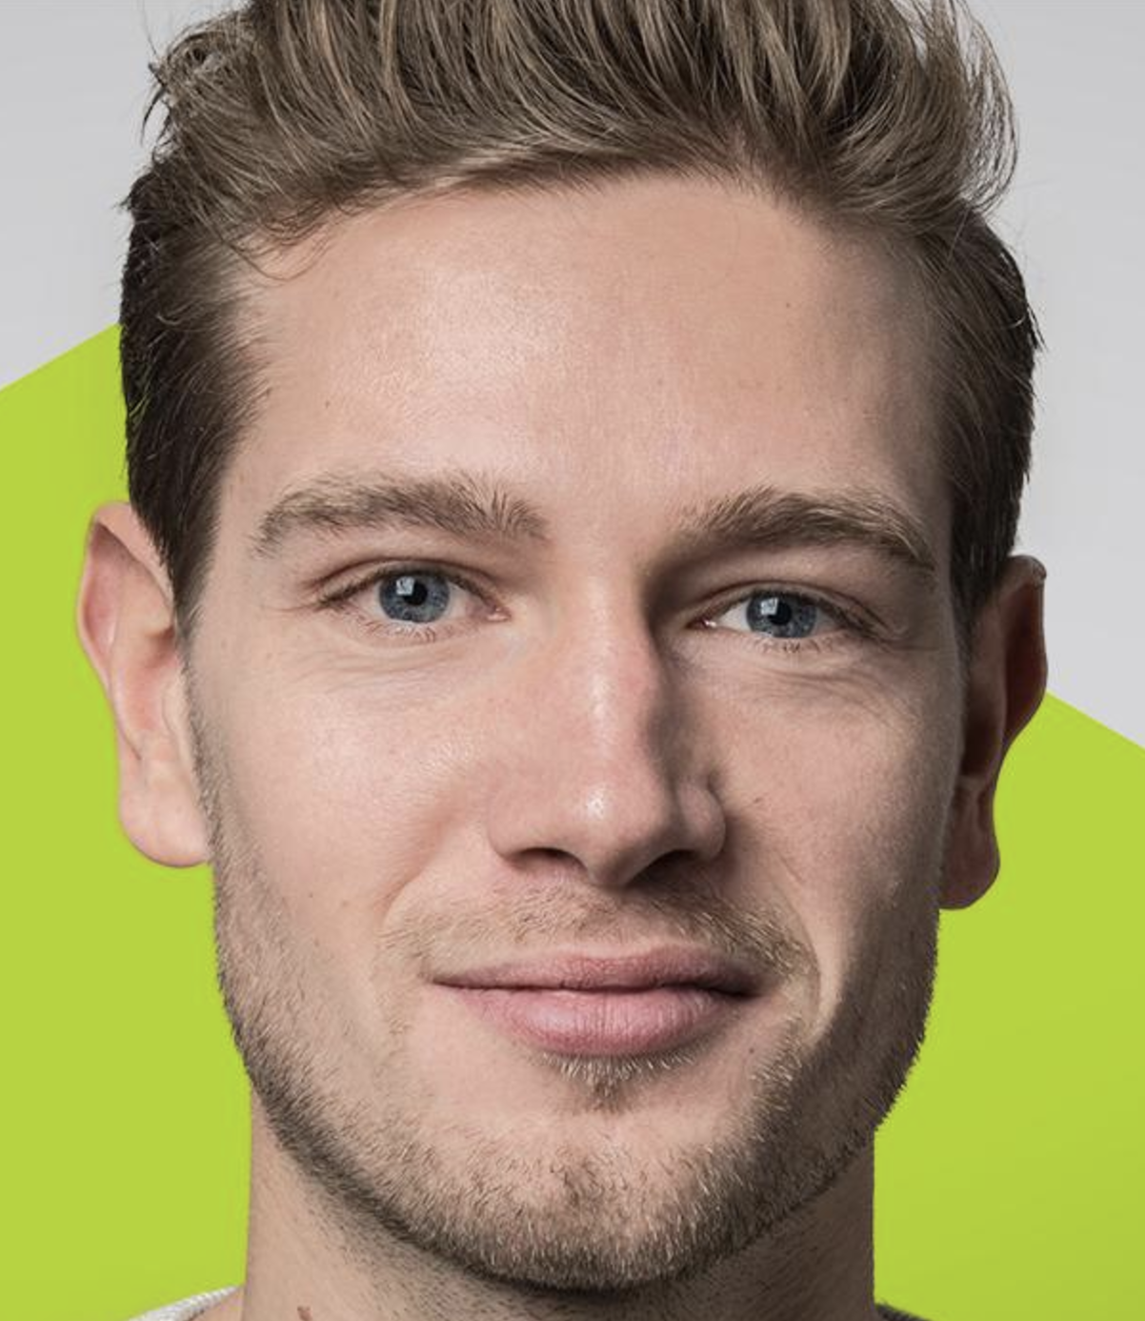
Prize
Or

Slide 11
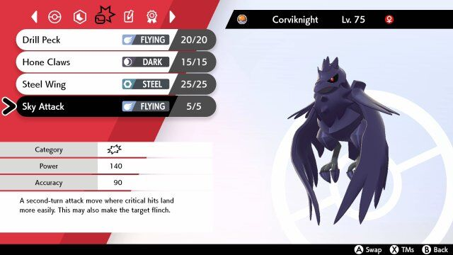
Fight
Attacks first the fastest pokemon
By default, each movement is selected randomly.
You can submit your own code to choose the movement priority
Then the second pokemon attacks

Slide 12
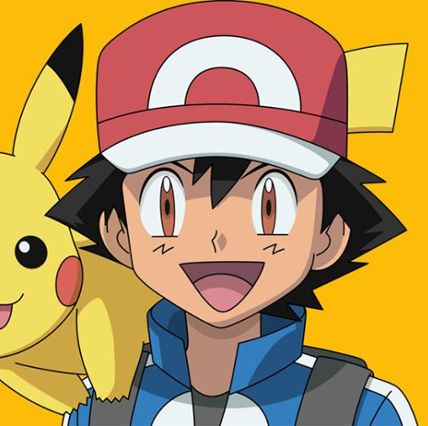
Considerations
There are damage movements + stats modifiers to increase or decrease
If you are run out of movement points (PP), there is a default movement that does damage to the openent + the user

Slide 13
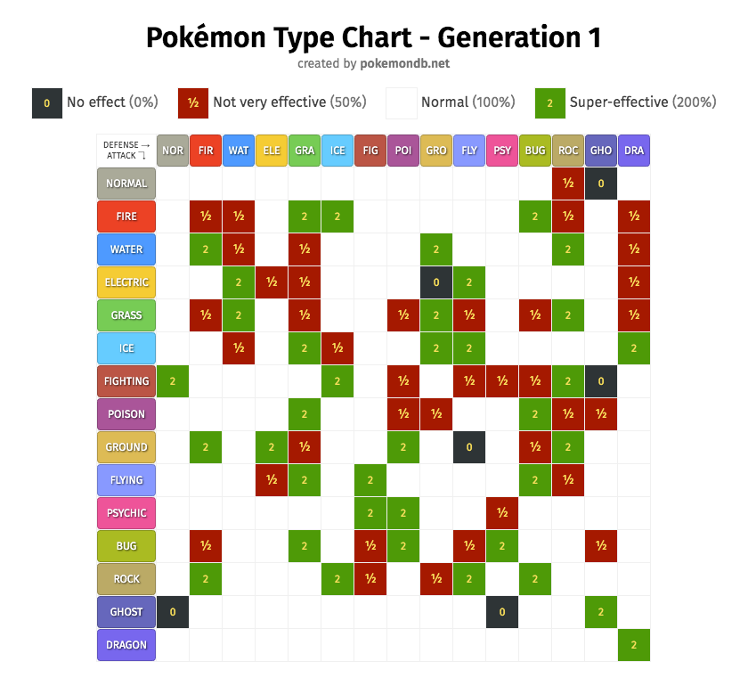
Considerations
Depending on the type of the movement + the type of the defender, the movement damage gets a modifier that increases or decreases the power.
If the Attacker uses movements of its own type, movement damage is boosted
Physical movements use the Attk/Defense pokemon stats
Special movements use the Special Attk/ Special Defense pokemon stat

Slide 14
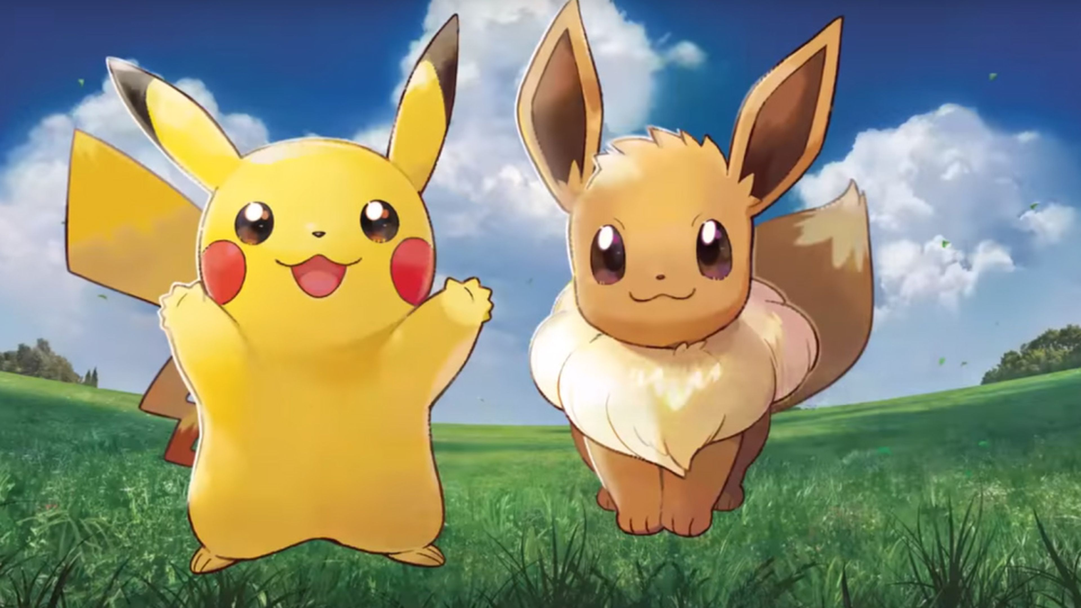
Have fun
Notes:
Repo: https://github.com/hectormirete/Pokemon-tournament/

